Slide 1
ITM7000 Master project
Dr. Qizhen Gu (Kimi)

Slide 2
Chapter 4 Research methodology
4.1 Research design
4.2 Sampling procedure
4.3 Research Instrument/ Questionnaire Design
4.4 Data Collection
4.5 Statistical Treatment of Data

Slide 3
4.1 Research Design
To describe the overall method that you used to integrate the different components of your study in a coherent and logical way.
Ensuring you effectively address the research problem.
Key Elements:
Type of Research Design: Quantitative, Qualitative, or Mixed-methods
Research Approach: Descriptive; Explanatory (aims to explain the impact of IVs on the DV.)
Justification for the Design: why this design is appropriate
Time Frame: data collected over time

Slide 4
4.2 Sampling procedure
To explain in detail how participants were selected
Including the sampling method, sample size determination, criteria for inclusion/exclusion.
Key Elements:
Target Population: Define who or what your study population
Sampling Method: Specify the sampling technique (non-probability)
Sample Size: Explain how you determined the number of participants
Inclusion/Exclusion Criteria: state criteria for participant selection.
Sampling Process: Describe practical steps (online survey sent via email）

Slide 5
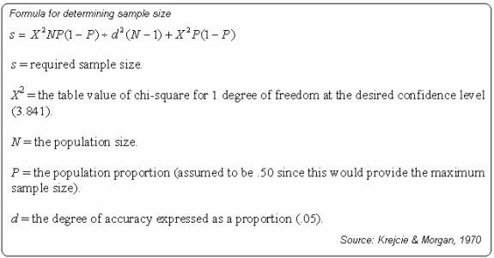
Sample Size Determination Using Krejcie and Morgan Table
KENPRO. (2012, August 25). Sample Size Determination Using Krejcie and Morgan Table. Kenya Projects Organization [KENPRO]. https://www.kenpro.org/sample-size- determination-using-krejcie-and-morgan-table/

Slide 6
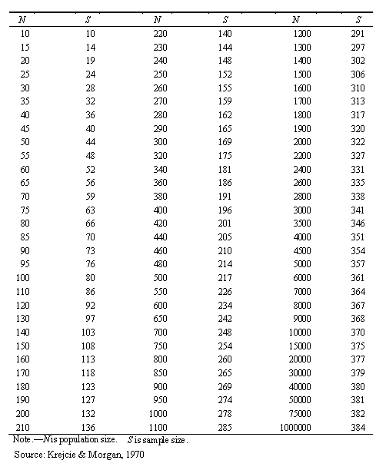
Sample Size Determination Using Krejcie and Morgan Table

Slide 7
4.3 Research Instrument / Questionnaire Design
Describes the structure, sources, validation, and scaling of your research instrument (the questionnaire).
Key Elements:
Type of Instrument: Specify that a structured questionnaire was used
Structure of the Questionnaire: Describe the main sections (variables; scanning question; demographics)
Source of Items: State whether items were adapted from previous studies
Measurement Scale: Indicate the scale used (5-point-likert scale)
Validity and Reliability Testing: Explain how the instrument was reviewed (pilot testing, Cronbach’s alpha)

Slide 8
4.4 Data Collection
To describe when, how, and from whom you collected your data
Key Elements:
Data Collection Period: Specify the timeframe for data collection.
Distribution Method: How the questionnaire was delivered (online)
Target Respondents: Clarify who was approached
Ethical Considerations: Mention informed consent, confidentiality
Data Quality Control: Explain how you checked for completeness and accuracy.
Response Rate: How many responses were received and the final usable sample size.

Slide 9
4.5 Statistical Treatment of Data
Explains which statistical techniques you used to analyze your data, why you chose them
How you ensured validity and reliability, it should align with your research objectives and hypotheses.
Key Elements:
Data Analysis Software: Statistical software (SPSS; Jamovi; SmartPLS)
Preliminary Analysis: Describe how you checked for missing data, outliers, or normality.
Descriptive Statistics: State how you summarized sample characteristics and main variables (e.g., mean, standard deviation, frequencies).

Slide 10
4.5 Statistical Treatment of Data
Key Elements:
Reliability and Validity Testing: Explain tests for reliability (e.g., Cronbach’s alpha) and validity (e.g., factor analysis).
Statistics Result: statistical tests used to answer your research questions/hypotheses (Multiple Linear Regression; mediating analysis )
Significance Level: State statistical significance (commonly p < 0.05).
Additional Analysis: mediation analyses. (if any)

Slide 11
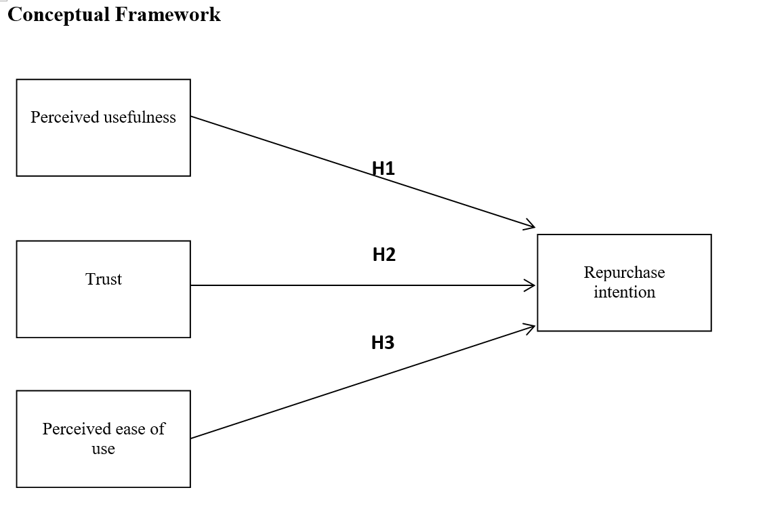
Examples

Slide 12
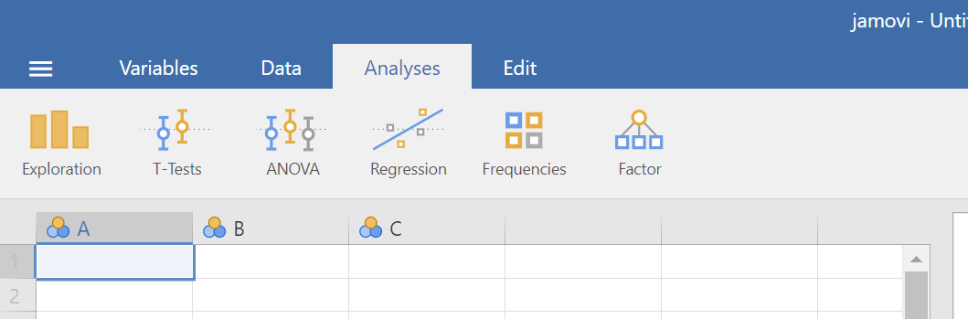
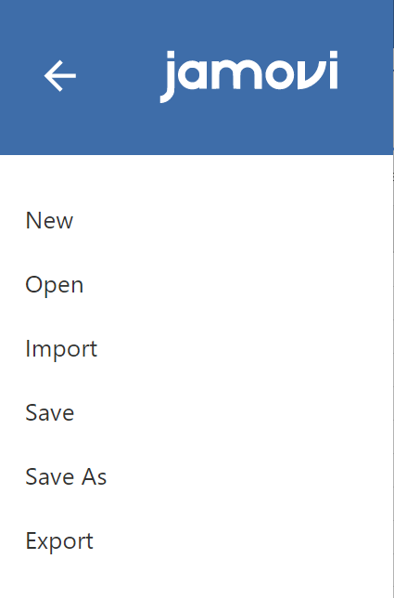
Open data
Open your data file

Slide 13
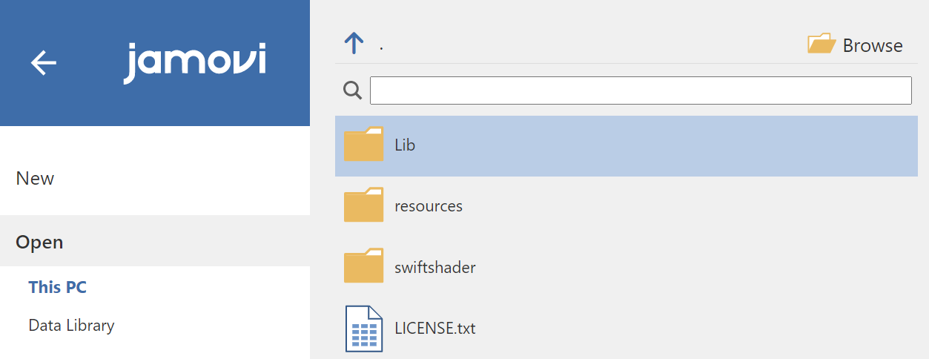
Open data
Click browse find you data file

Slide 14
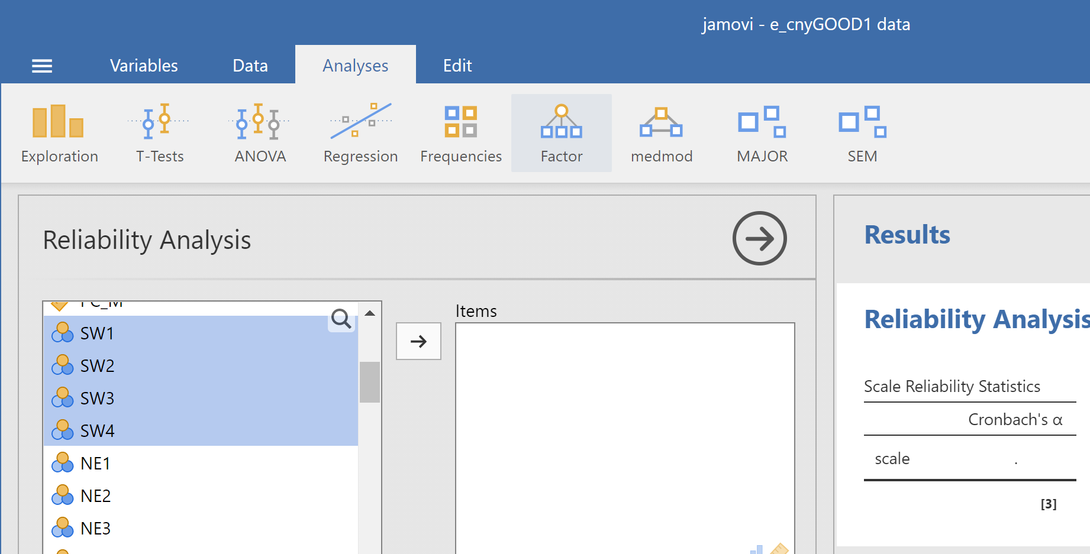
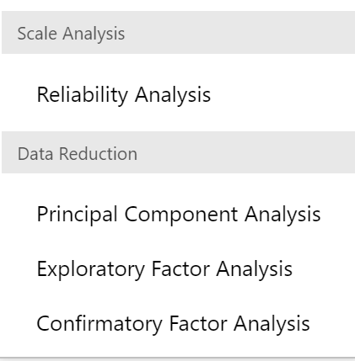
Reliability analysis

Slide 15
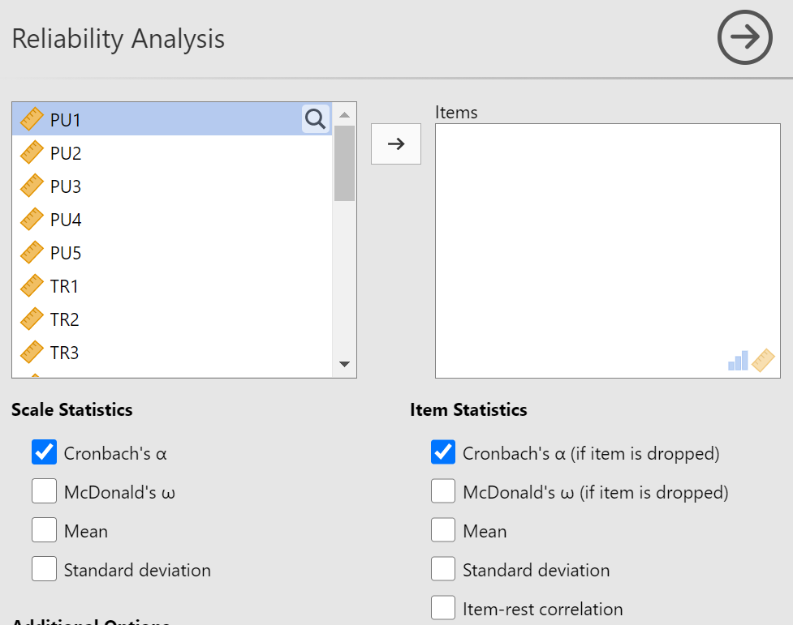
Reliability analysis
Select variable by variable

Slide 16
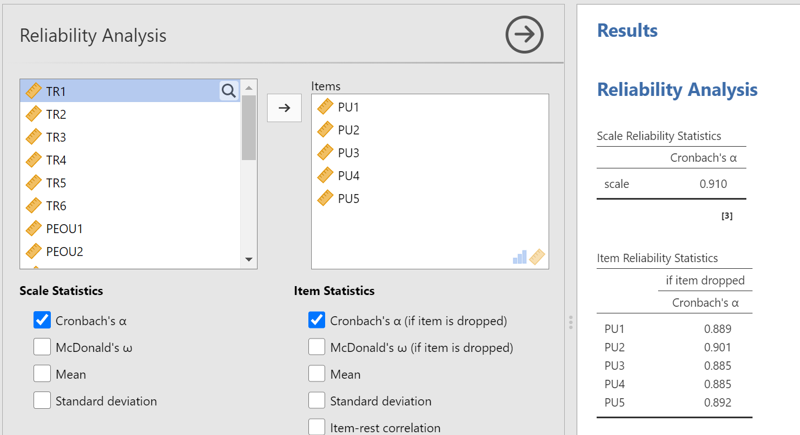
Reliability analysis
Analyze variable by variable

Slide 17
Reliability analysis
Analyze variable by variable
Cronbach's α. If it is ≥0.7, the questionnaire with this variable has no problem.
If this value is < 0.7, it indicates that the questionnaire does not have sufficient reliability.
There are various methods for remediation.
First, look for references. Some literatures emphasize that a value of Cronbach's α ≥0.6 meets the requirements.
Secondly, data can be collected again and tested again.
Thirdly, you can look at the table within the red box. Here it shows what the value of Cronbach's α will become if a certain problem is removed.

Slide 18
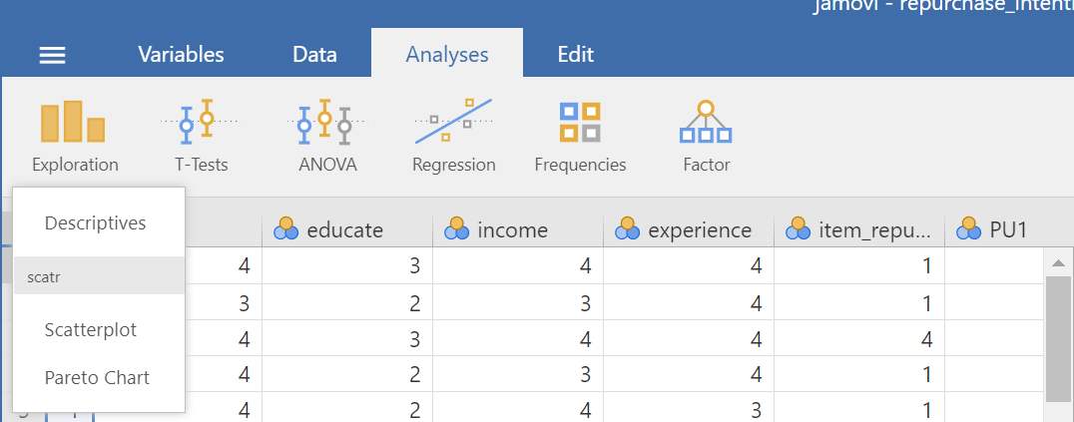
Descriptive analysis

Slide 19
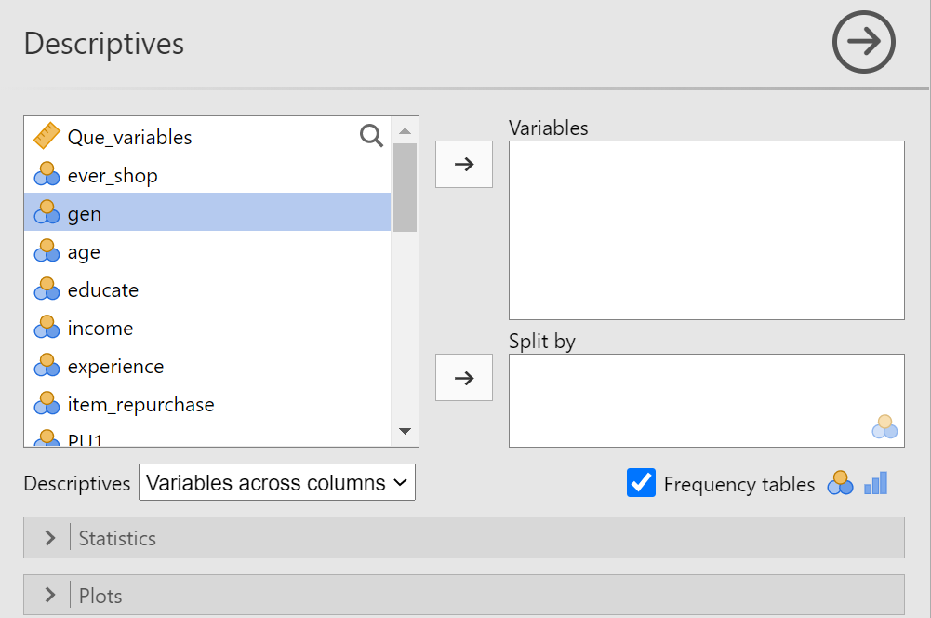
Descriptive analysis
Select the items on the left analysis interface and use the arrow keys to put it into the analysis box.
Here, some personal information-related issues can be analyzed, such as gender; Age Educational attainment Income and the like (the specific issue depends on everyone's research purpose)

Slide 20
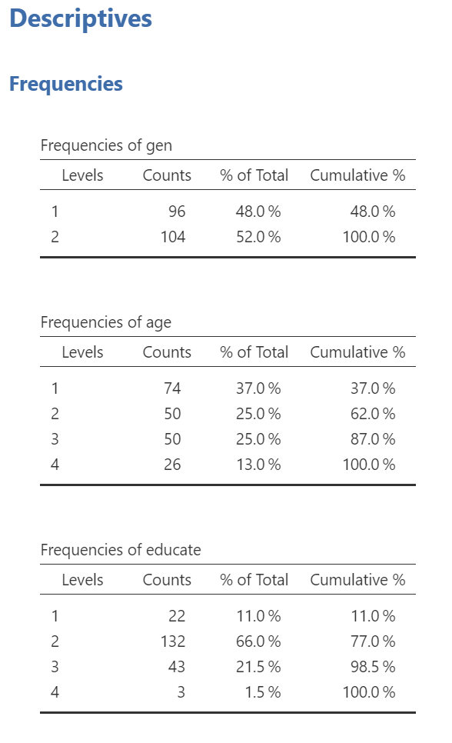
Descriptive analysis
For example: In this survey, 96 were male (1), 104 were female (2), and 74 respondents were under the age of 24. The number 50 is between 25 and 29. The number 50 is between 30 and 34. Twenty-six people are over 35 years old, etc.

Slide 21
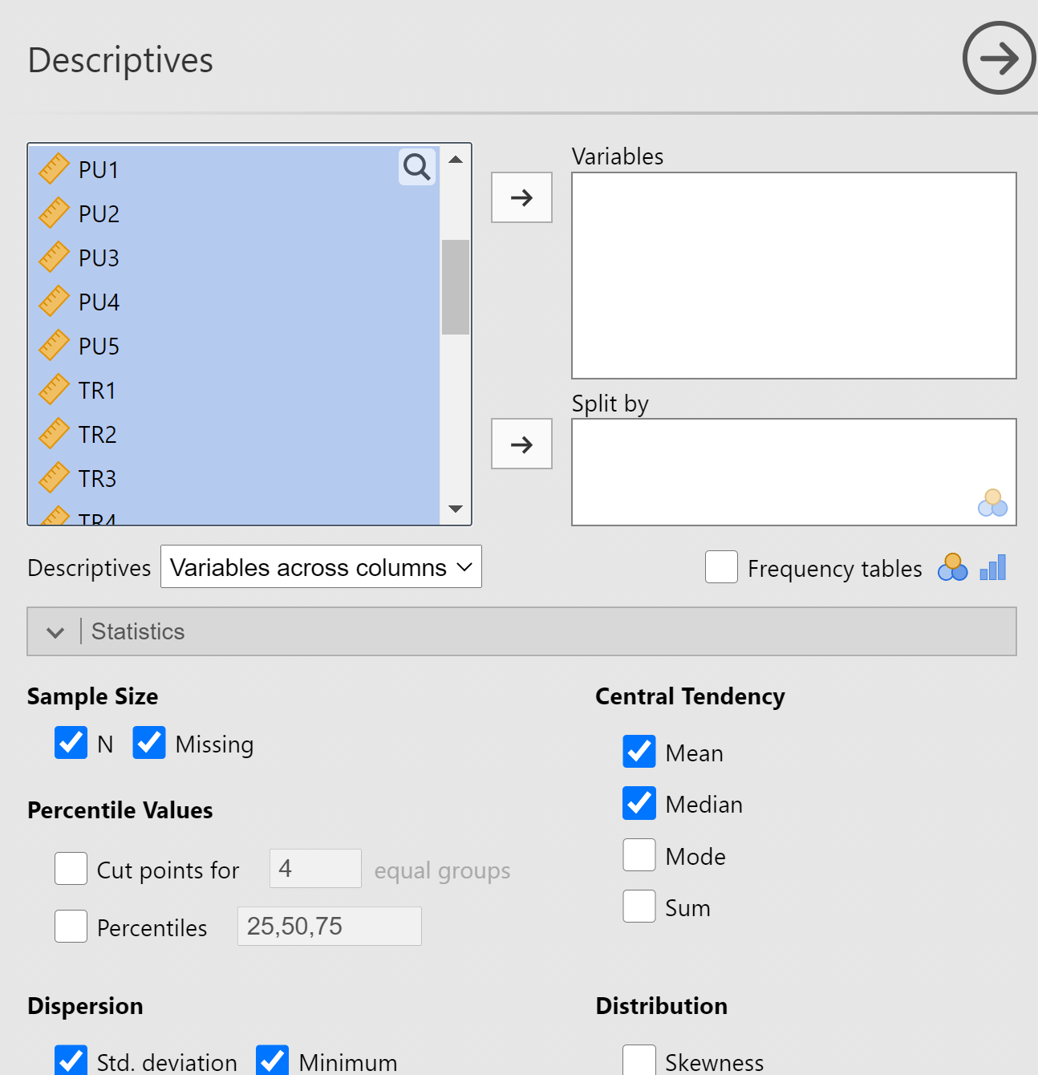
Descriptive analysis
Select all the items from all the variables (IV & DV & Mediator).
For further when we make recommendation for each IVs.

Slide 22
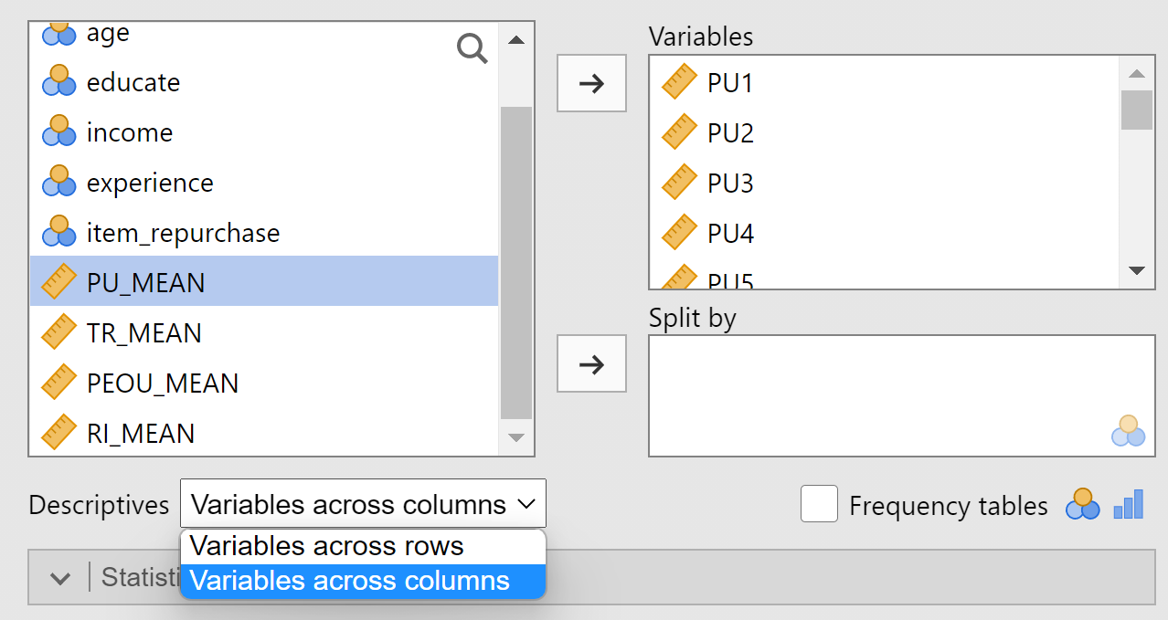
Descriptive analysis
Select Variables across rows, for better presentation

Slide 23
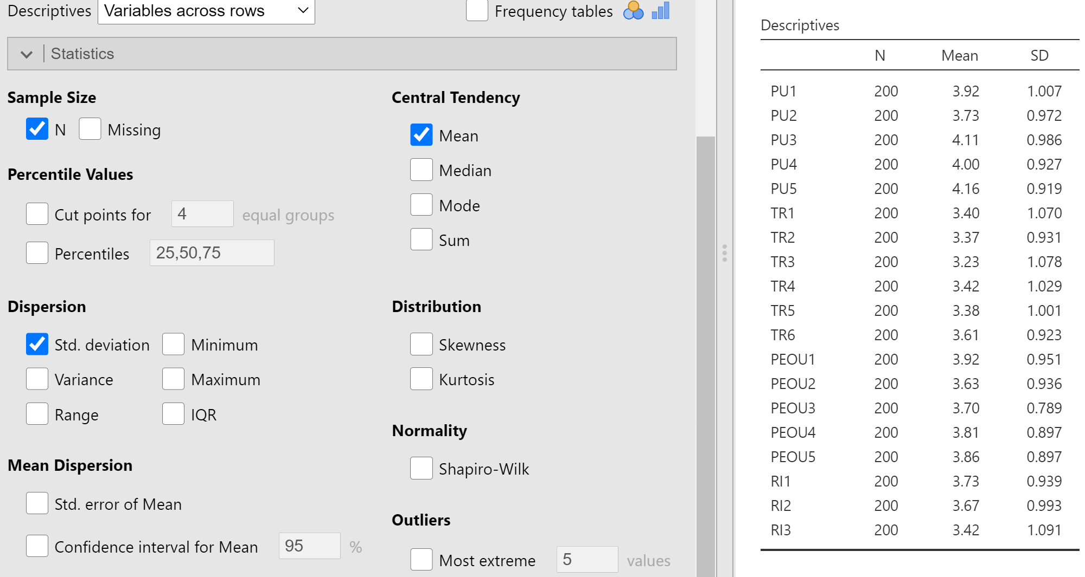
Descriptive analysis

Slide 24
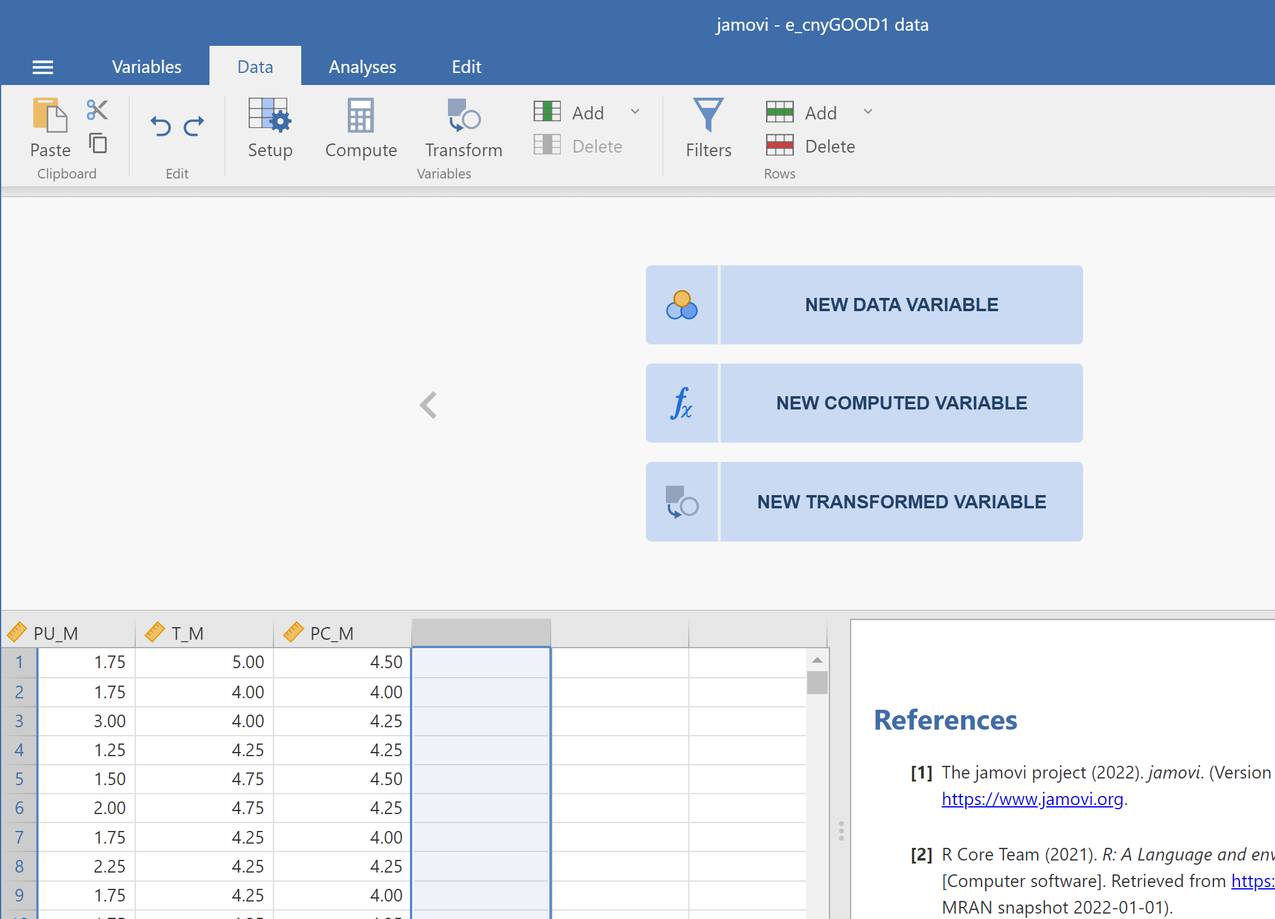
Multiple linear regression
Select, click empty column
And click new computed variable

Slide 25
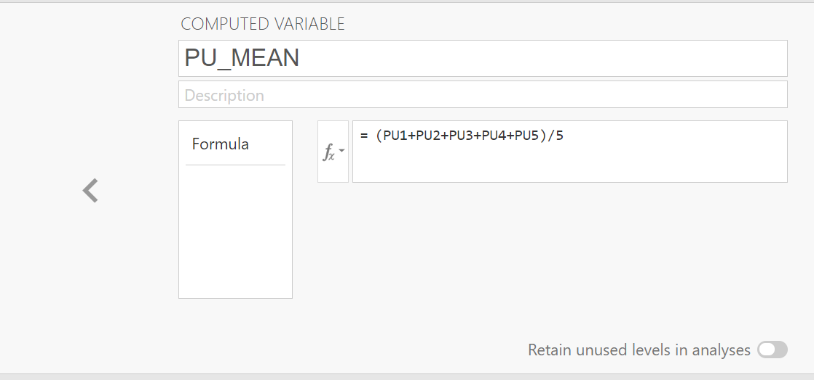
Multiple linear regression
Before analyzing the multilinear regression, we need to obtain the total average of each variable.
We need to calculate the average of each variable. For example, for the first variable PU, we calculate the sum of (PU1+PU2+PU3+PU4+PU5) and divide it by 5 to find the average.

Slide 26
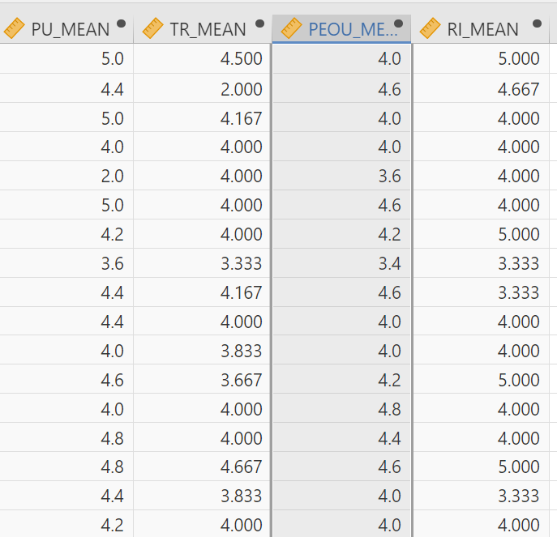
Multiple linear regression
In this example, there are four variables and we need to calculate four averages. After the calculation, we will obtain four new data columns.

Slide 27
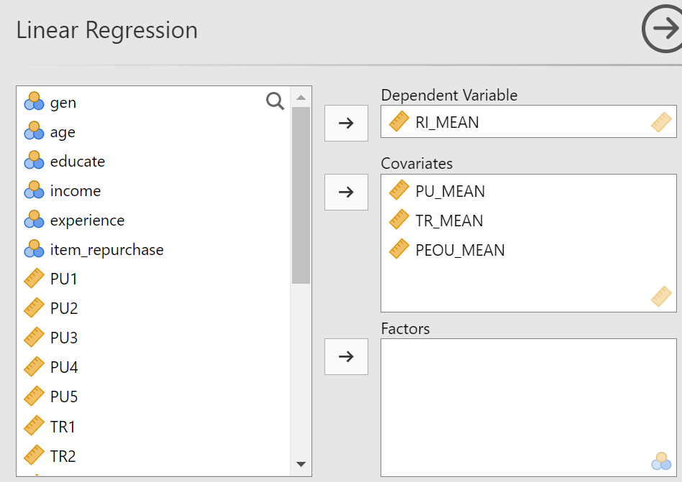
Multiple linear regression
DV
Here we need to insert the data column of the average of the variables we calculated earlier.
IV

Slide 28
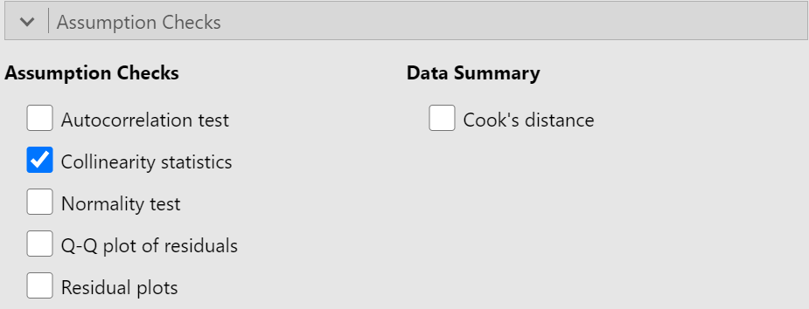
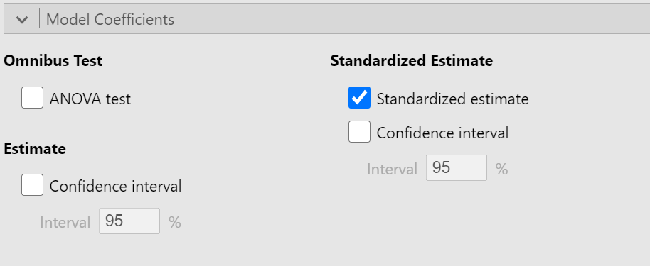
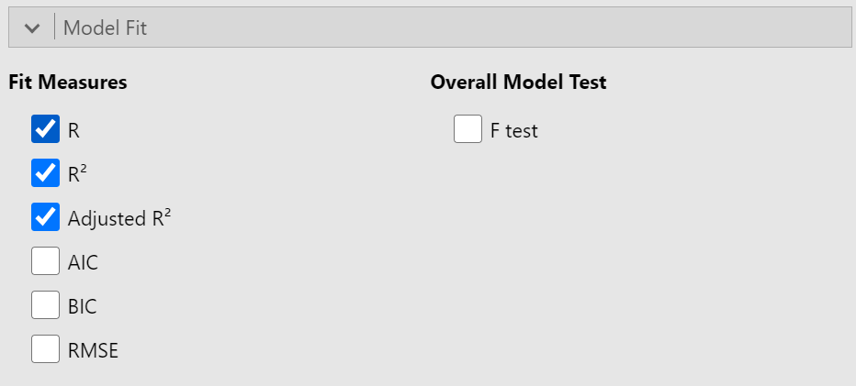
Multiple linear regression
After selecting the variables, the required options.

Slide 29
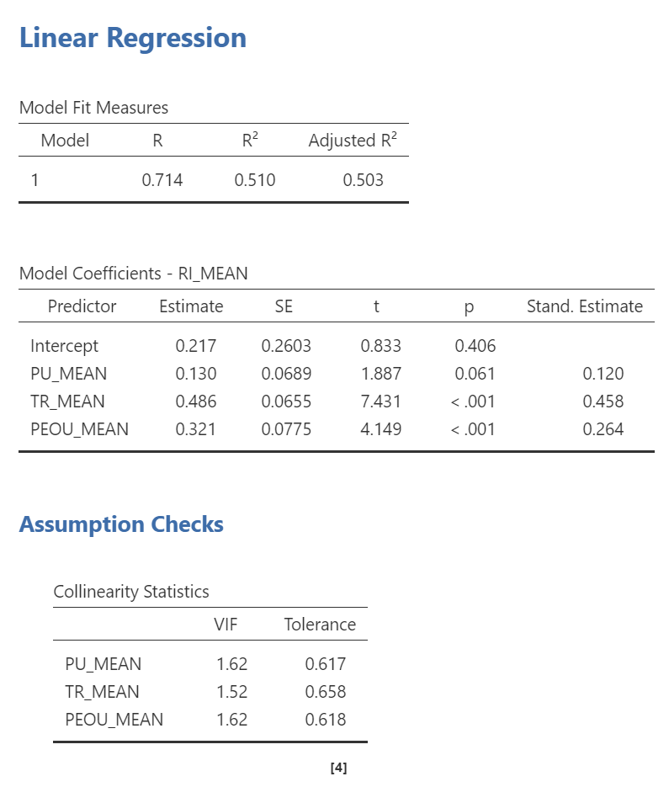
Multiple linear regression
Here, R² =0.510. This means that the three independent variables we analyzed can explain 51% of the dependent variables.
Here we can check whether there is a significant relationship between IV and DV (a P value ≤ 0.05 indicates a significant relationship).
Next, check β/ Stand Estimate /standardized beta coefficient.
This data indicates how strong the IV impact on the DV.
0.10-0.29 is regarded as having a relatively small force, 0.30-0.49 is regarded as having a moderate force, and > 0.50 is regarded as having a strong force.

Slide 30
Multiple linear regression
Finally, we need to analyze the collinearity VIF value. Different scholars have different opinions. Generally speaking, a value less than 5 is considered qualified, but some scholars believe that a value less than 10 is qualified.

Slide 31
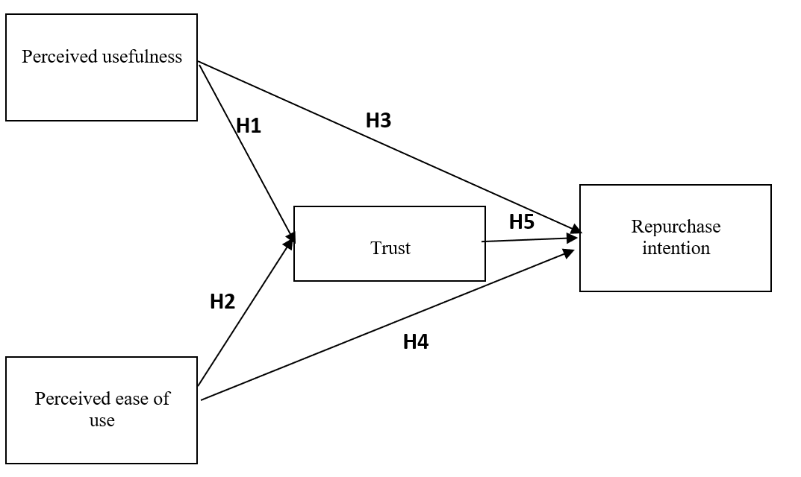
Examples

Slide 32
MLR ANALYSIS
Perceived usefulness & Perceived ease of use → Trust
Perceived usefulness & Perceived ease of use & Trust →Repurchase Intention
Trust → Repurchase Intention

Slide 33
Mediation analysis
Indirect and Total Effects
 |  |  |  |  |  |  |  | 95% C.I. (a)
Type |  | Effect |  | Estimate |  | SE |  | Lower |  | Upper |  | β |  | z |  | p
Indirect |  | PU_MEAN ⇒ TR_MEAN ⇒ RI_MEAN |  | 0.165 |  | 0.0407 |  | 0.08490 |  | 0.245 |  | 0.152 |  | 4.05 |  | < .001
 |  | PEOU_MEAN ⇒ TR_MEAN ⇒ RI_MEAN |  | 0.184 |  | 0.0457 |  | 0.09478 |  | 0.274 |  | 0.151 |  | 4.03 |  | < .001
Component |  | PU_MEAN ⇒ TR_MEAN |  | 0.339 |  | 0.0705 |  | 0.20040 |  | 0.477 |  | 0.332 |  | 4.80 |  | < .001
 |  | TR_MEAN ⇒ RI_MEAN |  | 0.486 |  | 0.0648 |  | 0.35943 |  | 0.613 |  | 0.458 |  | 7.51 |  | < .001
 |  | PEOU_MEAN ⇒ TR_MEAN |  | 0.379 |  | 0.0793 |  | 0.22368 |  | 0.534 |  | 0.331 |  | 4.78 |  | < .001
Direct |  | PU_MEAN ⇒ RI_MEAN |  | 0.130 |  | 0.0682 |  | -0.00365 |  | 0.264 |  | 0.120 |  | 1.91 |  | 0.057
 |  | PEOU_MEAN ⇒ RI_MEAN |  | 0.321 |  | 0.0767 |  | 0.17111 |  | 0.472 |  | 0.264 |  | 4.19 |  | < .001
Total |  | PU_MEAN ⇒ RI_MEAN |  | 0.295 |  | 0.0733 |  | 0.15107 |  | 0.439 |  | 0.272 |  | 4.02 |  | < .001
 |  | PEOU_MEAN ⇒ RI_MEAN |  | 0.506 |  | 0.0825 |  | 0.34421 |  | 0.667 |  | 0.415 |  | 6.13 |  | < .001
Note. Confidence intervals computed with method: Standard (Delta method)
Note. Betas are completely standardized effect sizes

Slide 34
Assignment #3
Submit your questionnaire to my email: guqizhen@au.edu
Section 1: Scanning question (set up 2-3 questions based on your target population)
Section 2: Demographic Question (depend on your research design, can be Gender; Age; Income; Education level)
Section 3:Scale items (that use to measure all your variables)

Slide 35
Thank you
Faculty member of ITM
guqizhen@au.edu

